Slide 1
WP4: 5GTANGO SDK Demonstration Presenter: Manuel Peuster (Paderborn University)

Slide 2

SDK demo: Let’s develop a network service!
We are going to …
create a new network service project
browse 5GTANGO network service project and add files
complete the service to be used in WP3 and WP5 demos
use SDK tools to debug and fix the service and its function chain
package service to a single *.tgo package file
on-board package to 5GTANGO V&V and to OSM
Perspective during this demo: Network service developer!

Slide 3
Involved 5GTANGO components
tng-workspace
tng-schema
tng-package
tng-project
tng-sdk-descriptgen
tng-sdk-validate
tng-on board
Project creation
Packaging
&
Uploading
Service & runtime Emulation
Testing & Debugging
Modeling & monitoring
Validation
Image
& SM Preparation
Descriptor writing
5GTANGO Service Development Kit Workflow
Notes:
Many are CLI tools, and all are well-integrated and supporting end-to-end scripting and automization

Slide 4
Network service to be developed
in
out
VNF1: HAProxy
VNF2: Squid

Slide 6

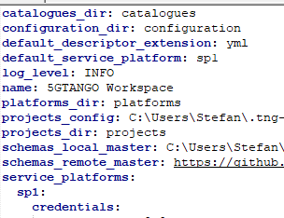
Step 1: Initialize 5GTANGO SDK workspace
tng-workspace
.tng-workspace/
├── catalogues
├── configuration
├── platforms
├── projects
│ └── config.yml
└── workspace.yml
trigger
setup
workspace.yml
tng-workspace
Developer
(that’s us)

Slide 7
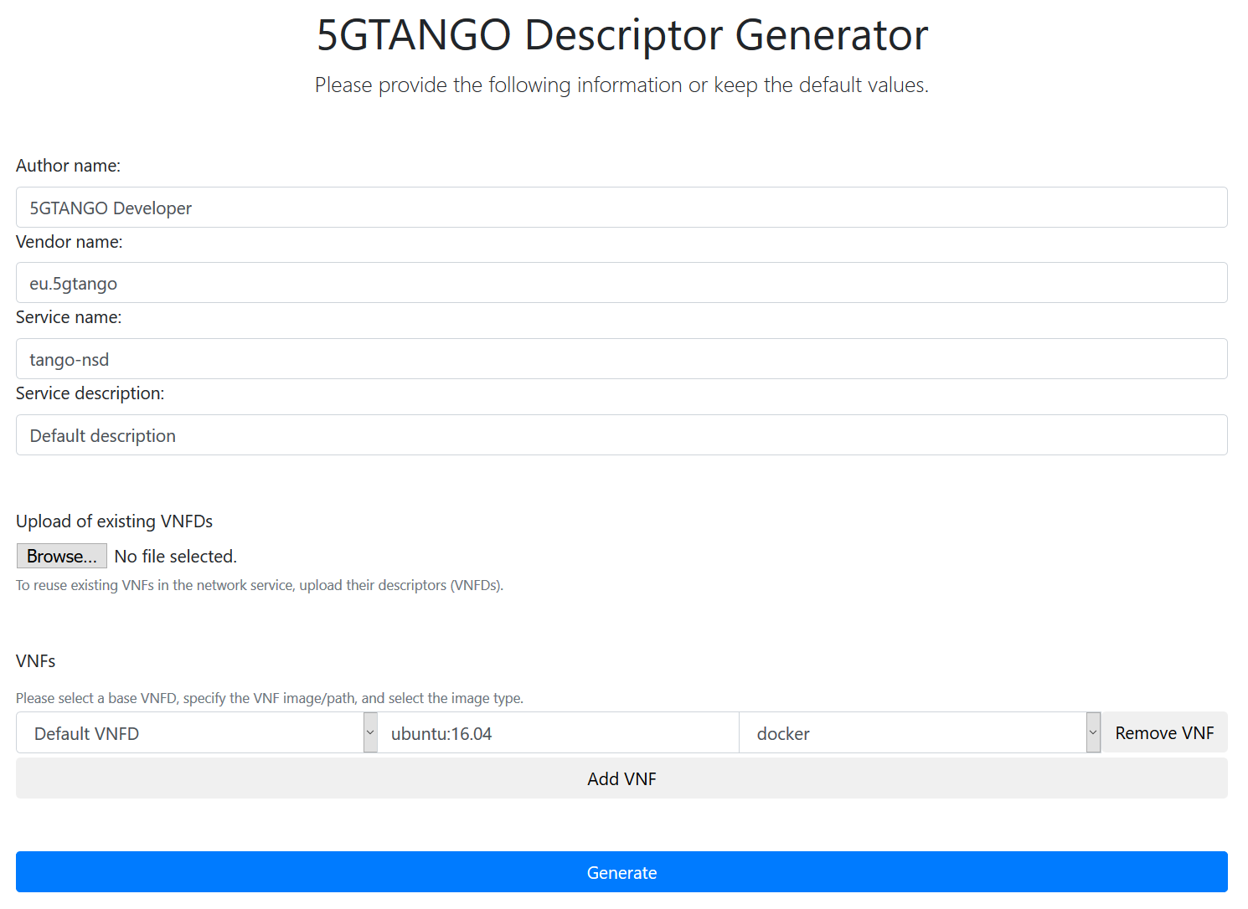
Step 2: Initial descriptor & project generation
project.yml
high-level info
generate
nsd.yml
vnfd.yml
vnfd.yml
vnfd.yml
Developer
(that’s us)

Slide 8
Step 3: Manipulate project
LICENSE.txt
copy
project.yml
trigger
add
tng-package
nsd.yml
vnfd.yml
vnfd.yml
vnfd.yml
Developer
(that’s us)

Slide 9
Step 4: Switch to prepared project
project.yml
edit
nsd.yml
vnfd.yml
vnfd.yml
Developer
(that’s us)
vnfd.yml
git pull

Slide 10
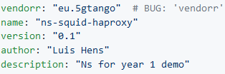
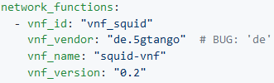
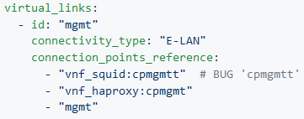
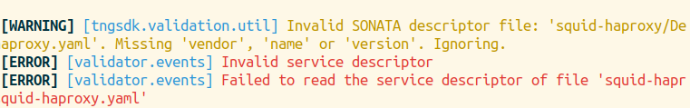
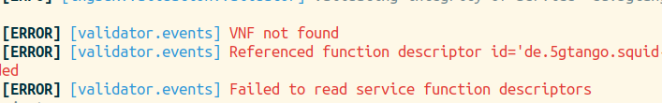
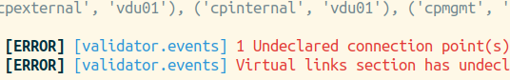
Step 5: Find bugs using tng-validate
Bug 1: Syntax error (typo)
Bug 2: Integrity error
(incorrect reference)
Bug 3: Topology error
(incorrect connection point)
Notes:
TODO add graph overlay

Slide 11
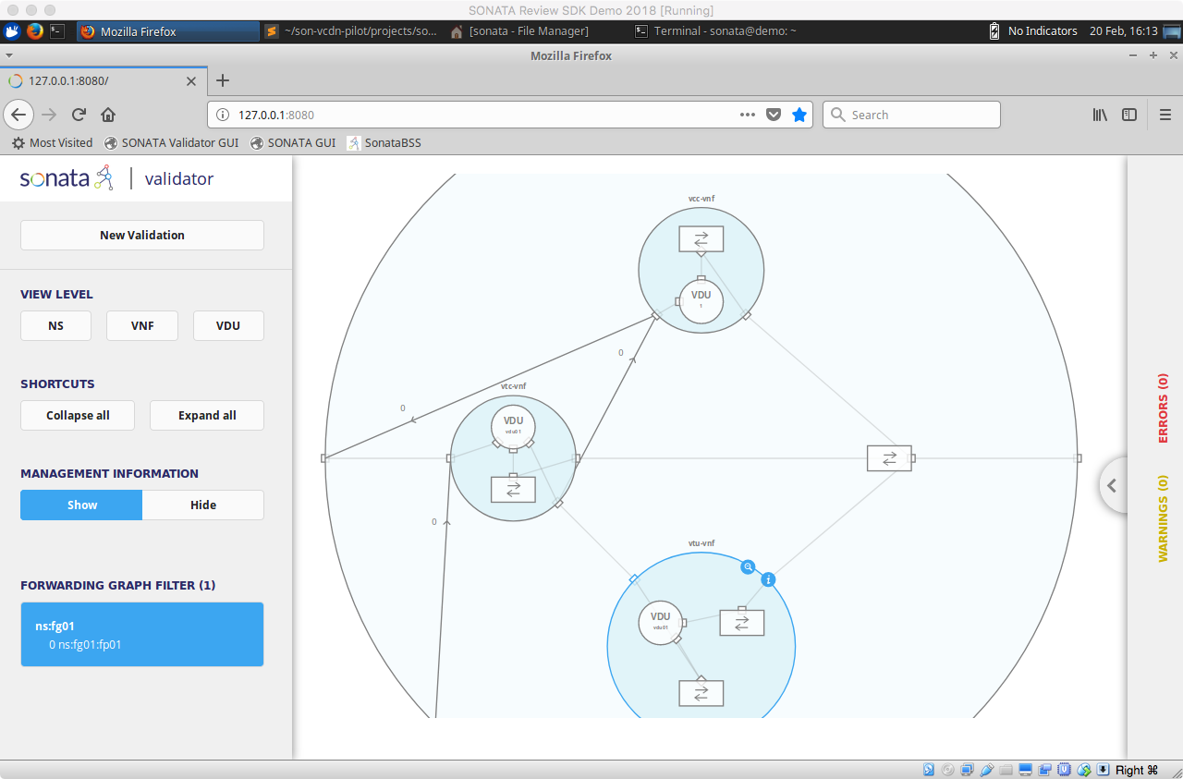
Step 6: Analyze the validated service in GUI
analyze/check
Developer
(that’s us)

Slide 12
Step 7: Package validated service
project.yml
nsd.yml
vnfd.yml
ETSI VNF Pkg. Format
(ETSI SOL004) compatible
vnfd.yml
vnfd.yml
read
trigger
write
tng-package
Developer
(that’s us)
5GTANGO package

Slide 13


Step 8: On-board to 5GTANGO and OSM
V&V
on-board
Developer
(that’s us)
5GTANGO package

Slide 14
Ready for instantiation!

Slide 15
5GTANGO SDK: Key takeaways
Simple, graphical generation of service descriptors and projects
User friendly management of network service projects
Easy-to-use validation tool for fast identification of a vide variety of bugs and errors prior to service deployment
Powerful, fully automated packaging procedure generating standard-compliant packages
Generic, extensible 5GTANGO package format compatible with OSM
Fully integrated service development kit for NFV!
Speeding up the service development cycle!
Notes:
So lets finish with the key points you should take away from this demo

Slide 16
Q&A

Slide 17
Demo Screenshots

Slide 18
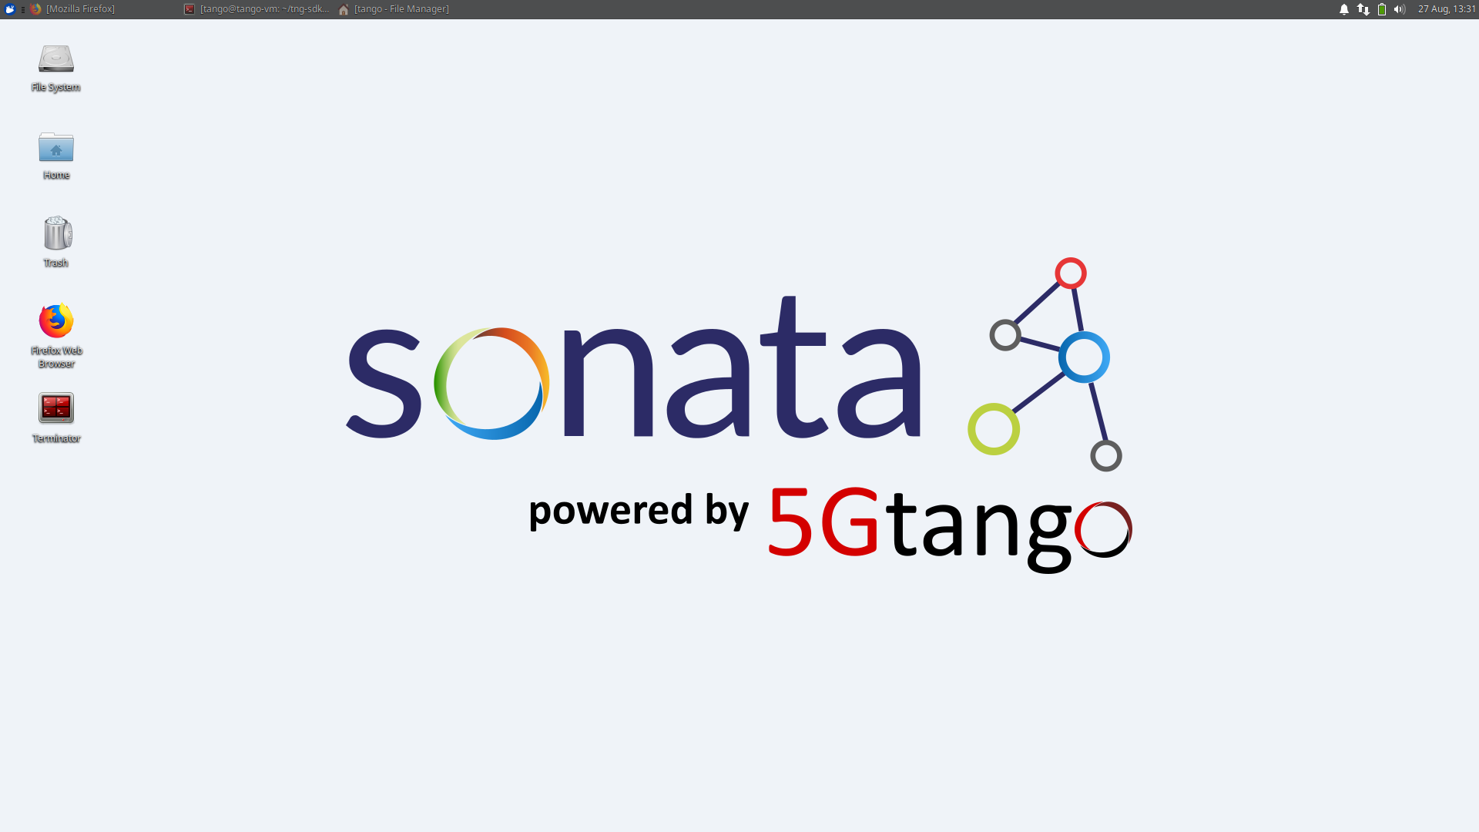
Starting point: Xubuntu 18.04 VM

Slide 19
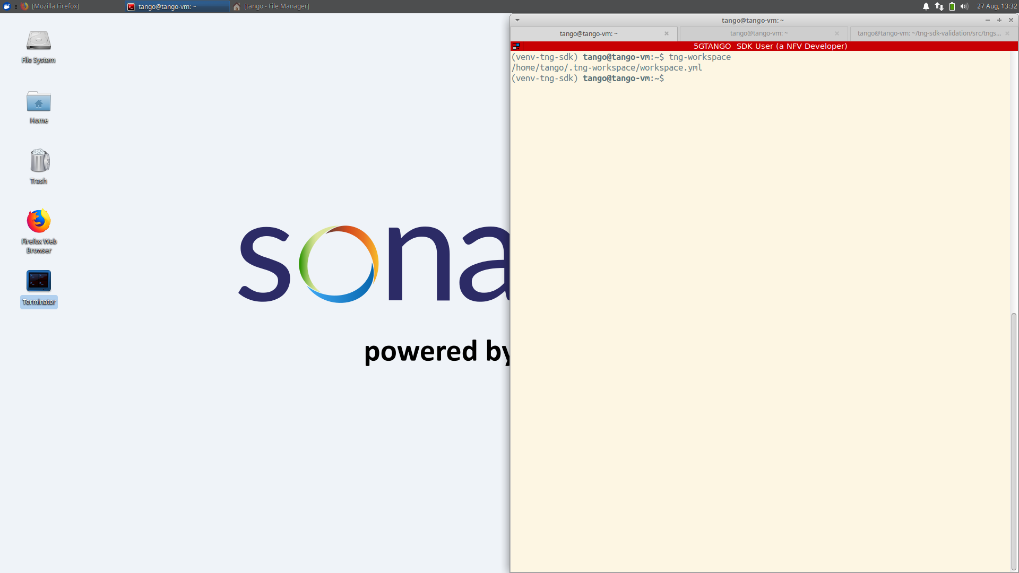
Initialize workspace

Slide 20
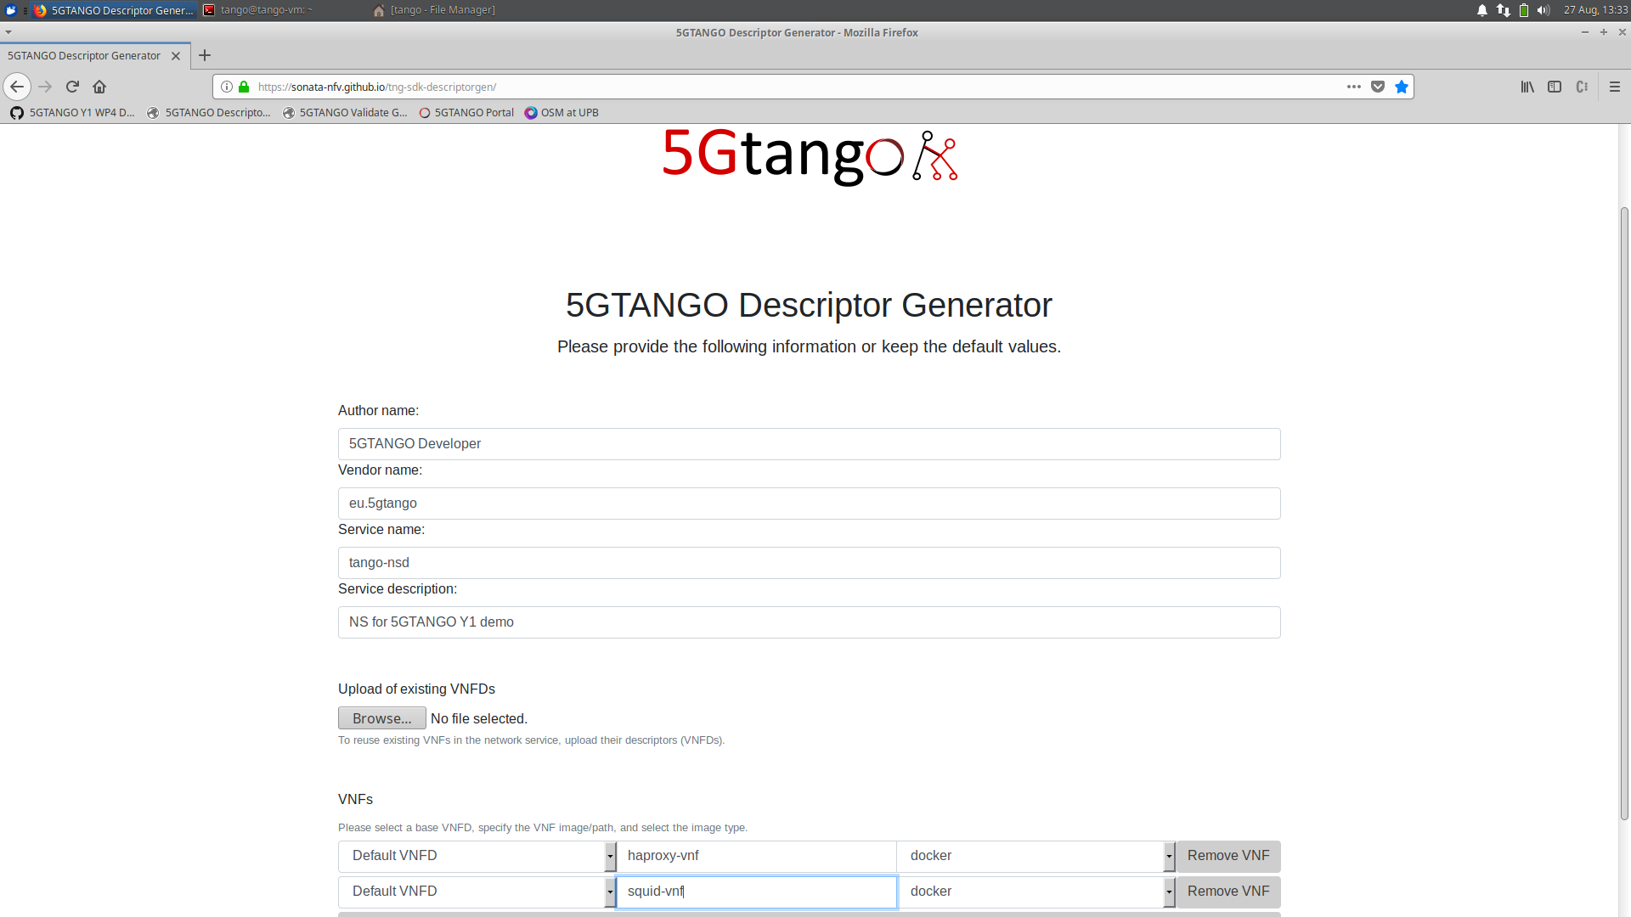
Descriptor generation: Enter high-level info

Slide 21
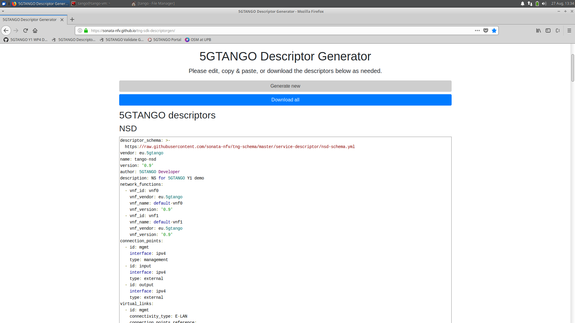
Descriptor generation: Generated descriptors

Slide 22
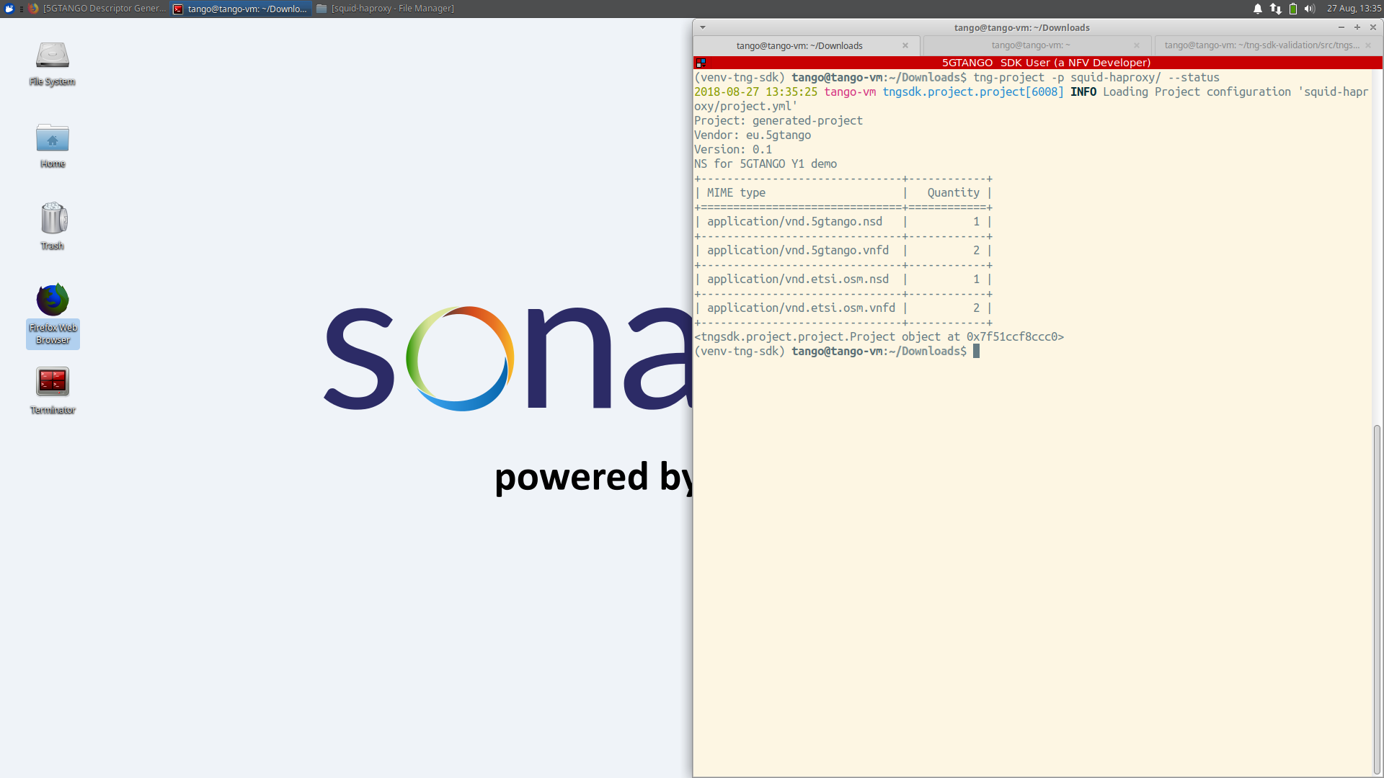
Status of generated project

Slide 23
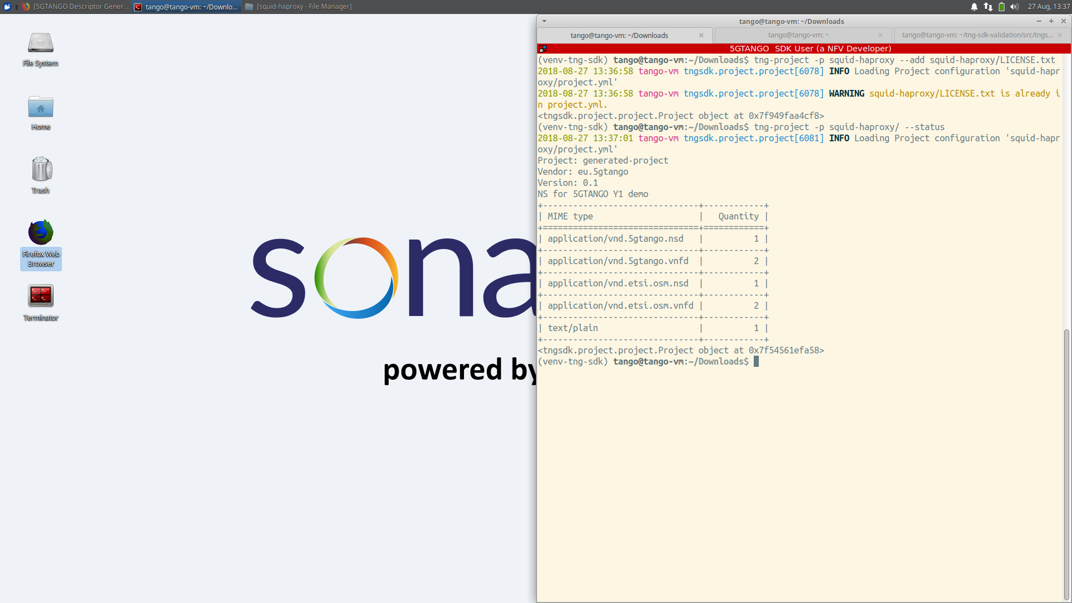
Add license file to project

Slide 24
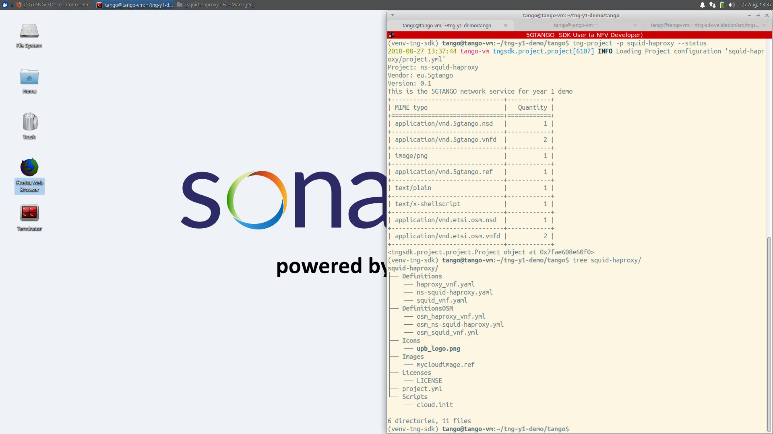
Switch to prepared project

Slide 25
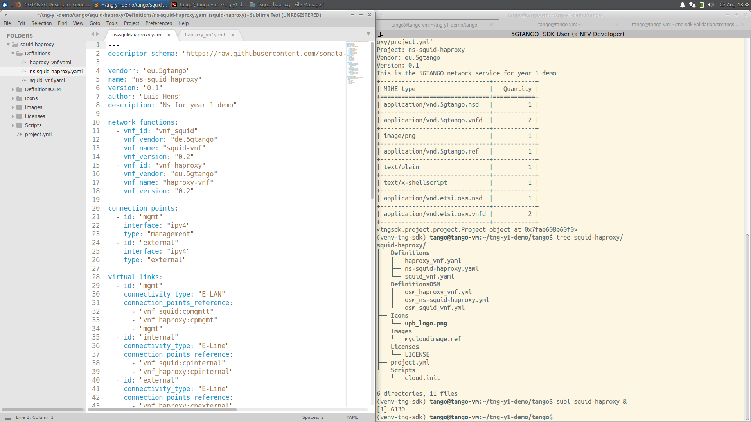
Network service descriptor

Slide 26
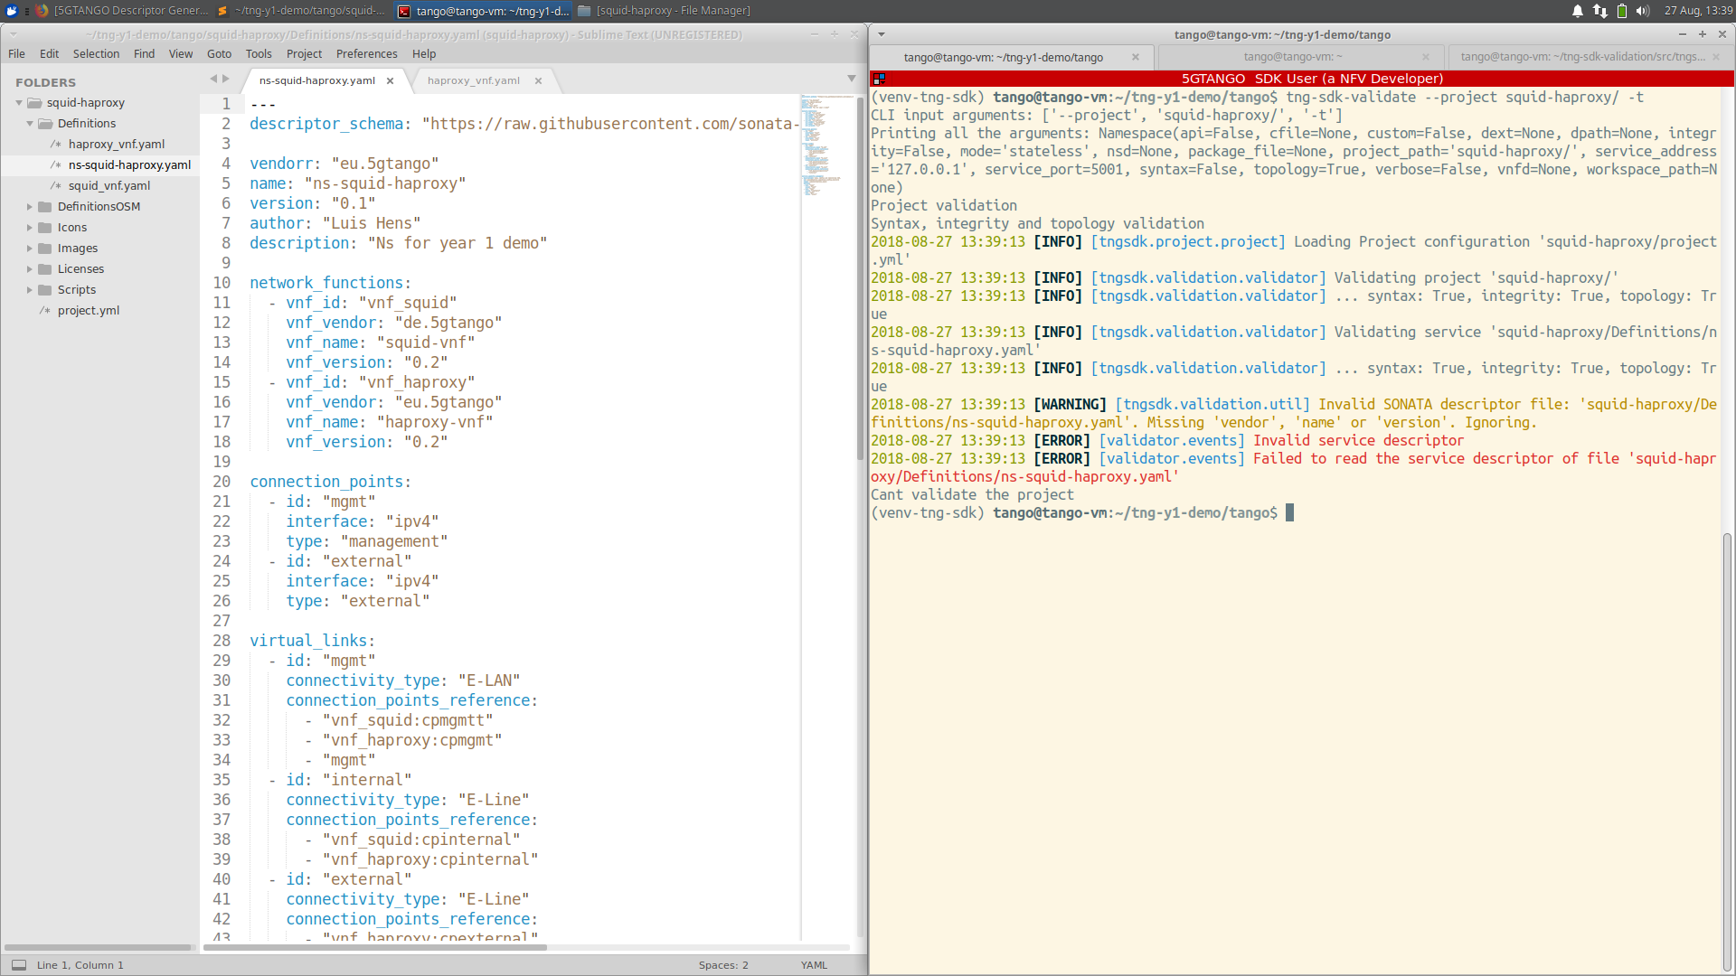
Descriptor validation: Syntax error (vendorr)

Slide 27
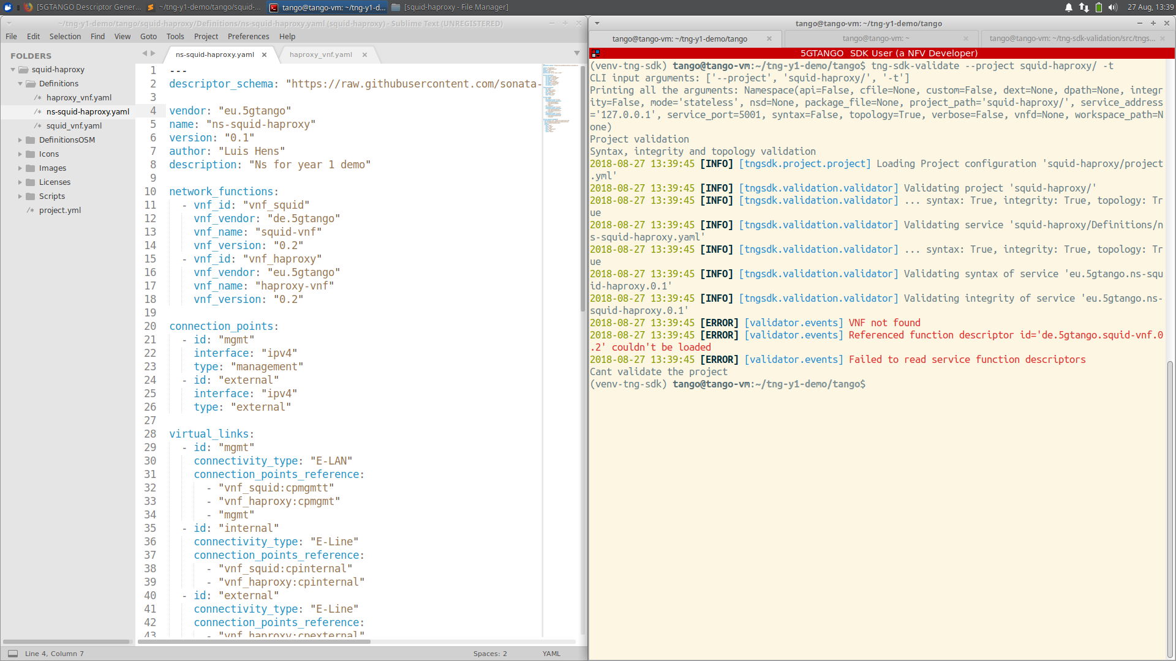
Descriptor validation: Integrity error (de.5gtango)

Slide 28
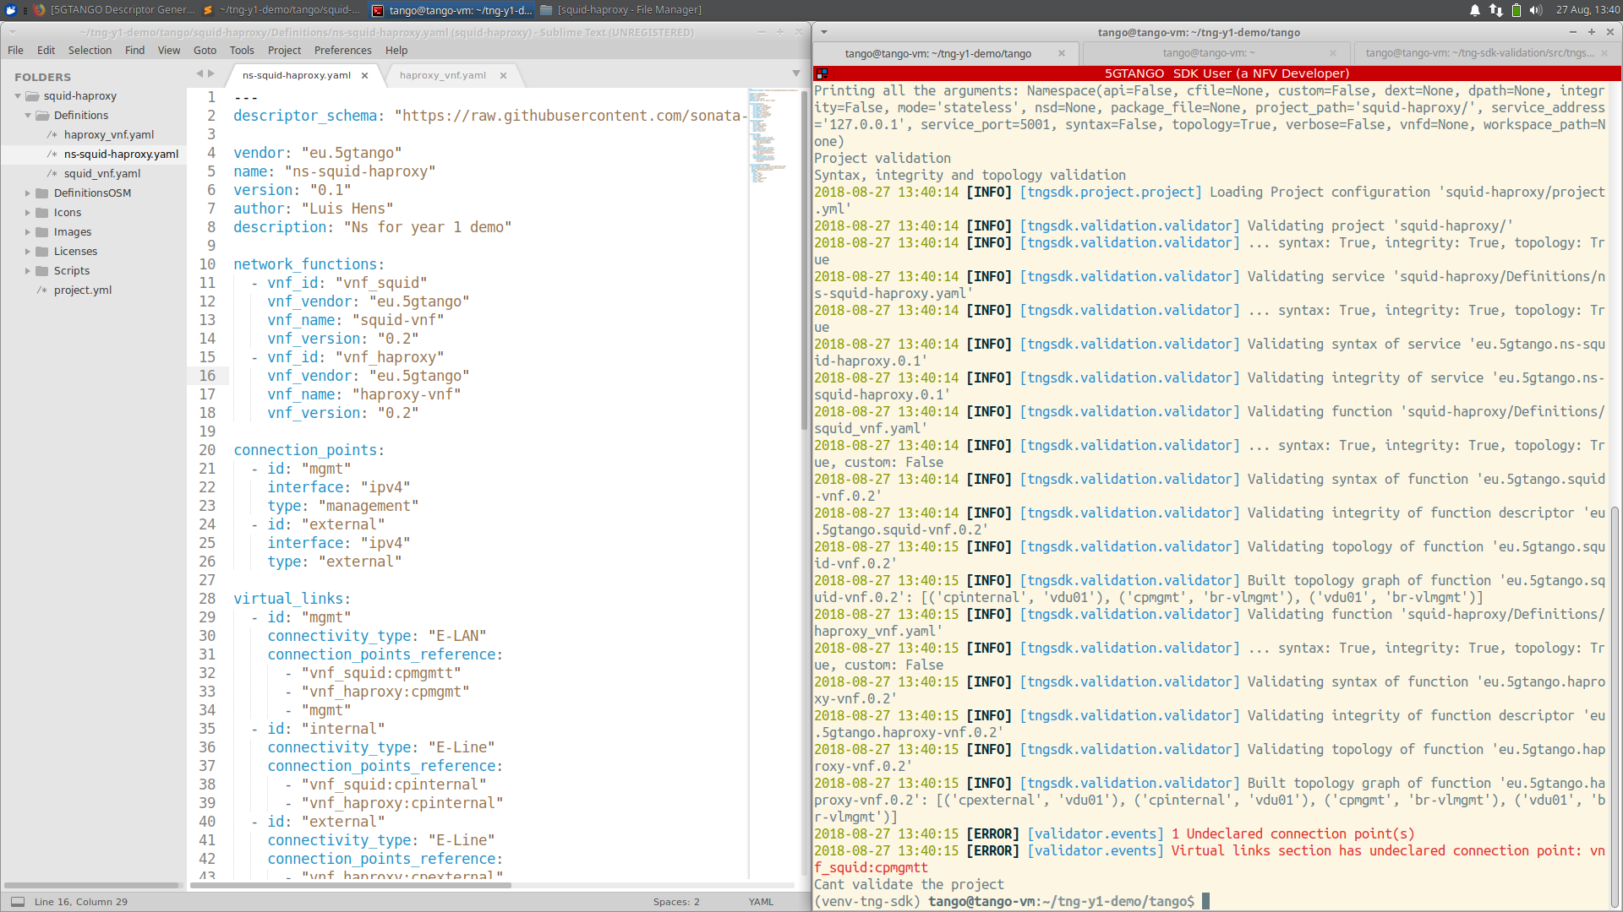
Descriptor validation: Topology error (conn. point)

Slide 29
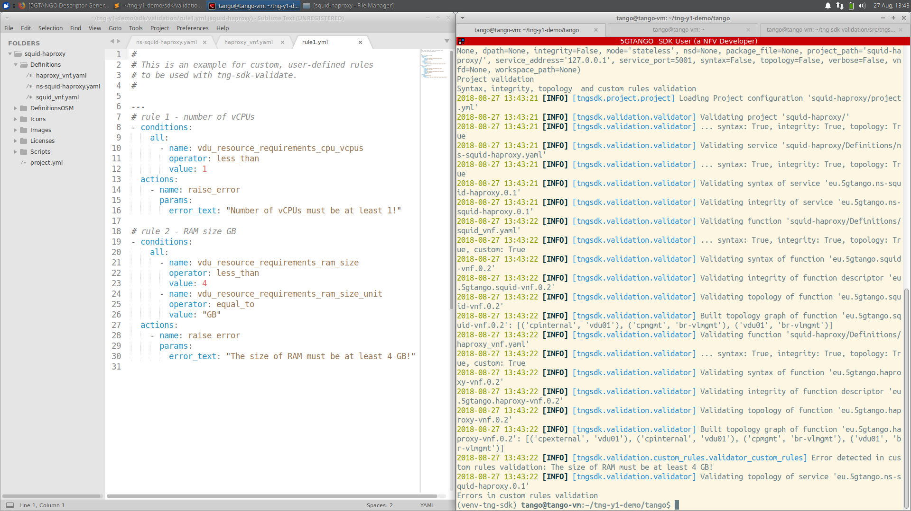
Descriptor validation: Custom rule

Slide 30
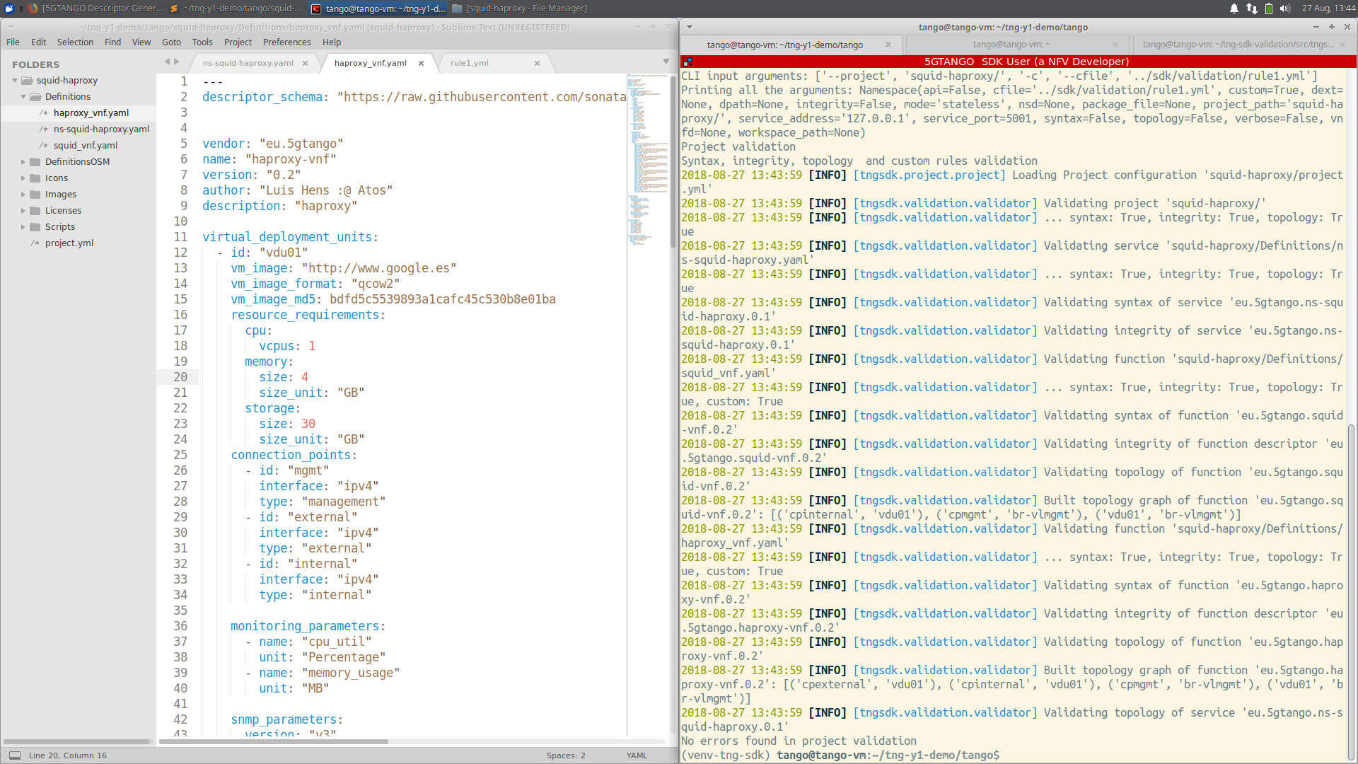
Descriptor validation: No more errors

Slide 31
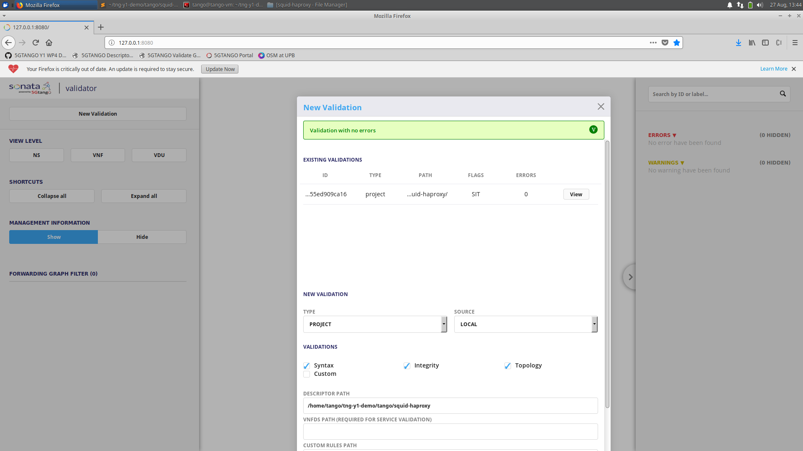
Validator GUI: New validation

Slide 32
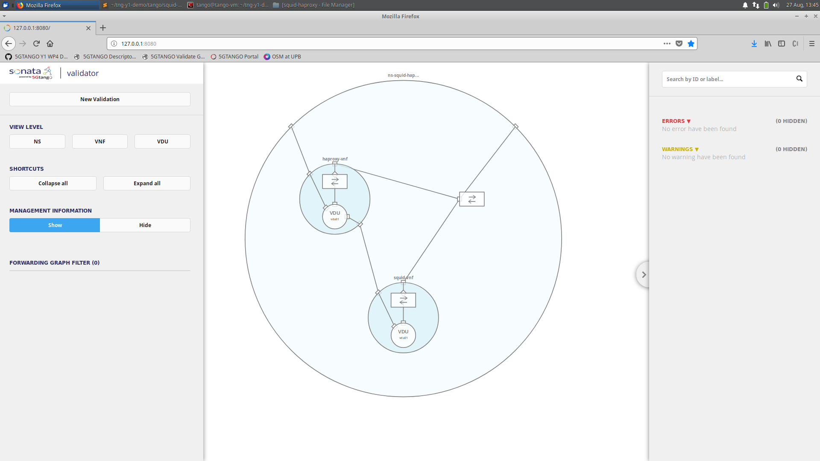
Validator GUI: Service topology overview

Slide 33
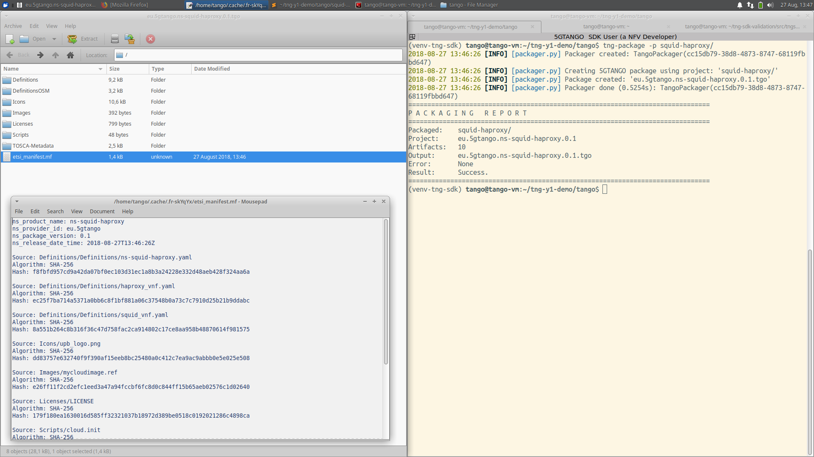
Package validated project

Slide 34
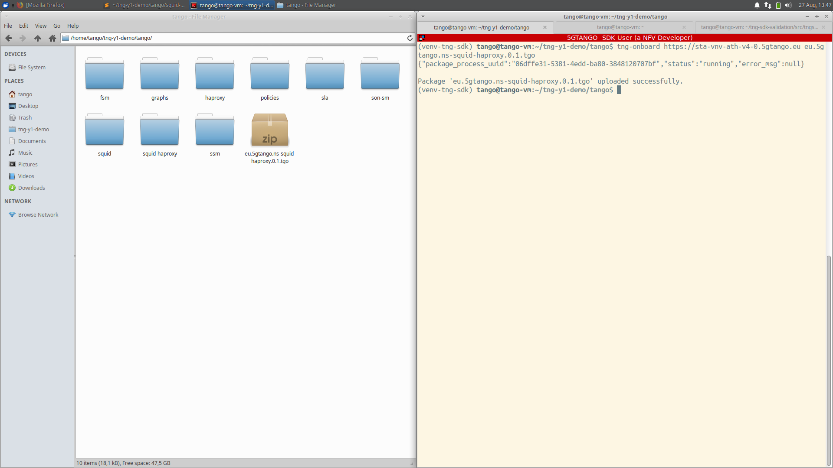
On-board package to 5GTANGO V&V

Slide 35
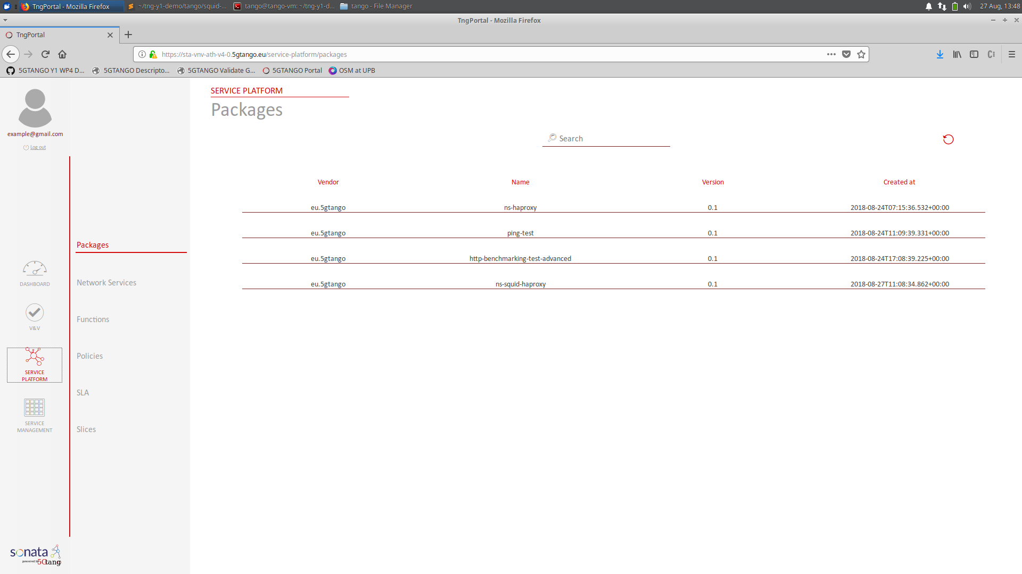
On-boarded to 5GTANGO successfully

Slide 36
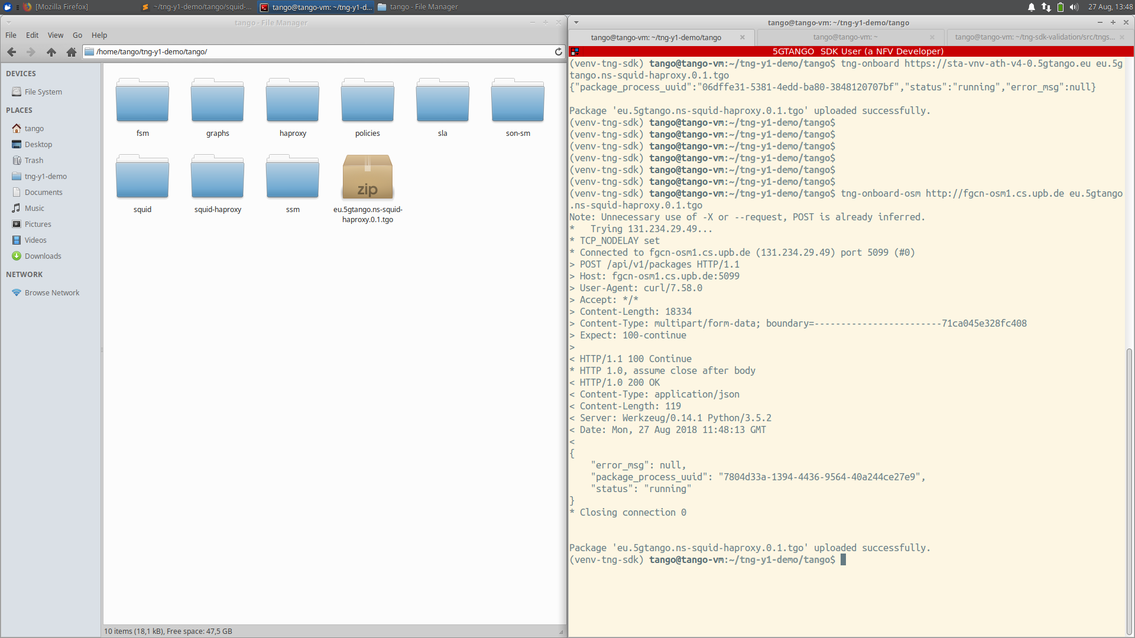
On-board package to OSM

Slide 37
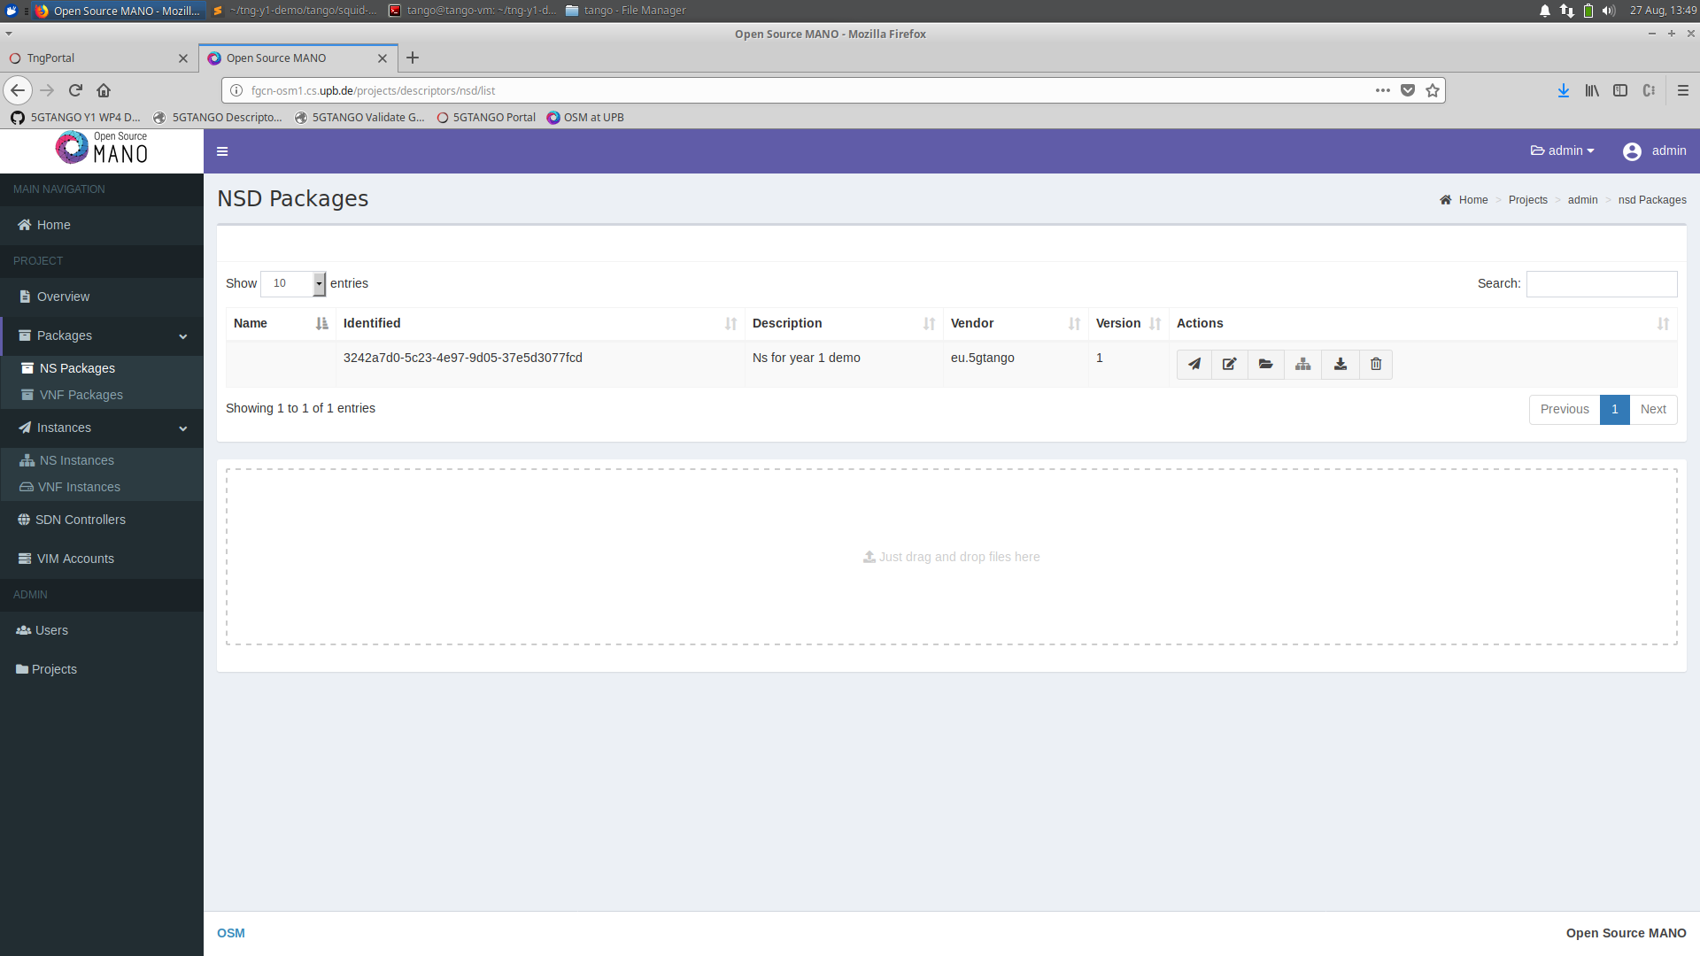
On-boarded to OSM successfully

Slide 38
Backup slides

Slide 39
Involved 5GTANGO components
5GTANGO Descriptors & Package Format
5GTANGO SDK Tools (subset)
tng-sdk-workspace
tng-sdk-descriptorgen
tng-sdk-project
tng-sdk-validate
tng-sdk-package
5GTANGO V&V or SP
5GTANGO portal
Plan
Dev
Monitor
Operate
Develop
Test
Ops
Deploy

Slide 40
NFV Package Formats SOTA
TOSCA CSAR v1.0/1.1
ETSI SOL004 v2.3.1
SONATA Package Format
OSM Package Format
ONAP Package Format
OpenBaton Package Format

Slide 41
NFV Package Formats SOTA
TOSCA CSAR v1.0/1.1
ETSI SOL004 v2.3.1
SONATA Package Format
OSM Package Format
ONAP Package Format
OpenBaton Package Format
Package format implementations claim to be ”aligned”, but NONE of them is fully compatible.
Incompatible!

Slide 42
5GTANGO Package Format
5GTANGO package format aims to support different descriptor types (OSM, 5GTANGO, SONATA, …)
All additional features are optional and implemented in a way that keeps the package format backwards compatible to ETSI SOL004
5GTANGO SDK provides a set of tools to generate standard compliant packages from existing artifacts and descriptors

Slide 43
Packaging/Unpackaging
Problem: Package format might change, package creation is complex
Solution: Single tool for packaging/unpackaging
part of 5GTANGO SDK
Abstracts the actual package format
Automates checksum calculation, format validation, …
Not only CLI, but also micro-service with REST interface
tng-package
tng-package
SP/V&V/
Catalogue
CLI
pack
unpack
REST
SP/V&V/
Catalogue
OSM/5GTANGO
Catalogue

Slide 44
Step 7: Package details
Compatible to ETSI SOL004 (and thus to TOSCA CSAR)
Concept: Allow to package almost everything
(packages are just containers, we don’t care about semantics of their contents)
Innovations: Layering, references, tooling
Goal: Design the most generic, reusable, feature complete, and compatible package format in the NFV landscape!

Slide 45
Packaging/Unpackaging: Design
CLI and REST interface
Plug-able storage backends (e.g. filesystem, catalouge, …)
Async. REST interface w. callbacks (optional, helpful for fat packages)
tng-package
core
file sys.
CLI
catalogue
storage backend plugin
REST
OSM

Slide 46
Status and Outlook
5GTANGO SDK aims to be OSM compatible!
5GTANGO package format specification is available online:
http://tiny.cc/5GTANGO-pkg-spec
Tool design completed, implementation ongoing, all open source:
https://github.com/sonata-nfv/tng-sdk-package
First release: July 2018!

Slide 47
WP4: 5GTANGO SDK Demonstration Manuel Peuster, Stefan Schneider Paderborn University
Notes:
title slide for video

Slide 48


Thanks!
5G DEVELOPMENT AND VALIDATION PLATFORM FOR GLOBAL INDUSTRY-SPECIFIC NETWORK SERVICES AND APPS

